Slide 1
Module-4 Session Management

Slide 2
State Management
Requirement of state management
1) All web applications are stateless
2) All user can send the request to the web server but web server don’t know about request coming from same user or different user.
3) Using state management techniques we identify each user uniquely on same web page.

Slide 3
Session Management
Client Side State Management
View State,
Query String,
Cookie,
Hidden Fields
Server Side State Management
Profiles, Session State, Application State, cache

Slide 4
A web application is stateless. That means that a new instance of a page is created every time when we make a request to the server to get the page and after the round trip our page has been lost immediately. It only happens because of one server, all the controls of the Web Page is created and after the round trip the server destroys all the instances. So to retain the values of the controls we use state management techniques.

Slide 5
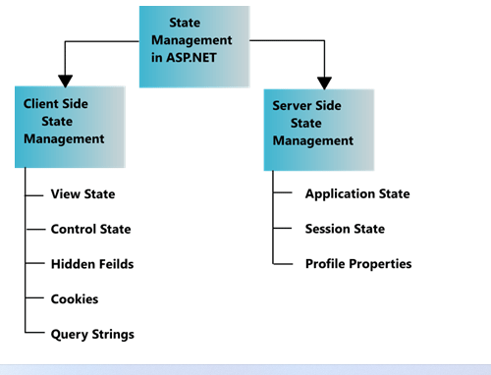
State Management Techniques

Slide 6
View State
View State is the method to preserve the Value of the Page and Controls between round trips. It is a Page-Level State Management technique. View State is turned on by default and normally serializes the data in every control on the page regardless of whether it is actually used during a post-back.

Slide 7
What is HiddenField?
HiddenField, as name implies, is hidden. This is non visual control in ASP.NET where you can save the value. This is one of the types of client-side state management tools. It stores the value between the roundtrip. Anyone can see HiddenField details by simply viewing the source of document.
<asp:HiddenFieldID="HiddenField1" runat="server" />

Slide 8
Events of HiddenFields
As a control, it should have events. HiddenFields has the following events.
ValueChanged event is server-side control. This event gets executed when the value of HiddenField gets changed between postback to the Server.
EVENT TYPE | DESCRIPTION
DataBinding | Occurs when Server Control binds to a data source.
Disposed | Occurs when Server Control is released from the memory.
Init | Occurs when Server Control is initialized.
Load | Occurs when server control get loaded on the page.
PreRender | Occurs before Rendering the page.
UnLoad | Occurs when Server Control is unloaded from memory.
ValueChanged | Occurs when the value gets changed between the round-trip (postback).

Slide 9
cookies
cookies is a small piece of information stored on the client machine. This file is located on client machines "C:\Document and Settings\Currently_Login user\Cookie" path. Its is used to store user preference information like Username, Password,City and PhoneNo etc on client machines. We need to import namespace called Systen.Web.HttpCookie before we use cookie.
Type of Cookies
Persist Cookie - A cookie has not have expired time Which is called as Persist Cookie
Non-Persist Cookie - A cookie has expired time Which is called as Non-Persist Cookie
How to create a cookie?
It is really easy to create a cookie in the Asp.Net with help of Response object or HttpCookie

Slide 10
Type of Cookies
Persist Cookie - A cookie has not have expired time Which is called as Persist Cookie
Non-Persist Cookie - A cookie has expired time Which is called as Non-Persist Cookie
How to create a cookie?
It is really easy to create a cookie in the Asp.Net with help of Response object or HttpCookie
Example 1
HttpCookie userInfo = new HttpCookie("userInfo");
userInfo["UserName"] = "Annathurai";
userInfo["UserColor"] = "Black";
userInfo.Expires.Add(new TimeSpan(0, 1, 0));
Response.Cookies.Add(userInfo);
Example 2
Response.Cookies["userName"].Value = "Annathurai";
Response.Cookies["userColor"].Value = "Black";

Slide 11
Constructors
HttpCookie(String) | Creates and names a new cookie.
HttpCookie(String, String) | Creates, names, and assigns a value to a new cookie.

Slide 12
Domain | Gets or sets the domain to associate the cookie with.
Expires | Gets or sets the expiration date and time for the cookie.
HasKeys | Gets a value indicating whether a cookie has subkeys.
HttpOnly | Gets or sets a value that specifies whether a cookie is accessible by client-side script.
Item[String] | Gets a shortcut to the Values property. This property is provided for compatibility with previous versions of Active Server Pages (ASP).
Name | Gets or sets the name of a cookie.
Path | Gets or sets the virtual path to transmit with the current cookie.
Value | Gets or sets an individual cookie value.
Values | Gets a collection of key/value pairs that are contained within a single cookie object.

Slide 13
Cookies with multiple values in asp .net
In this asp .net tutorial we will learn how to write,read and delete cookies with multiple values. Multiple values are stored in the form of name-value pairs in a single cookie. Cookies with more than one value are very useful to store related information into single cookie rather than creating and maintaining multiple cookies.
E.g. You can store Name and age of user in a single cookie rather than creating separate cookie for name and for age.
Cookies example in asp .net
Some of the advantages of using Multiple value cookies over single value cookies:
1) You can put similar information into a single cookie.
2) Using Multiple valued cookies also limits the number of cookie files supported by browser.
3) You can apply expiration to the cookie collection.

Slide 14
Query string
Query string is a simple way to pass some information from one page to another. The information can be easily pass to one page to another or to same page. With query string method the information passed in url of page request.
This method many browsers supports only 255 character length of url in query string. The value passed will be visible so some time it cause security issue.
For send information to other page Response.Redirect() method used and for retrieve information from url use Request.QueryString() method used.
In Query String method we can sent value to only desired page, and value will be temporarily. So Query string increase the overall performance of web application.

Slide 15
Syntax of Query String
Send information to other page
Response.Redirect(“nextpage.aspx?name=value”);
Retrieve information from other page
Request.QueryString[“name”].ToString();

Slide 16
Session State Management in ASP.Net
State management is a important part of any application. The Session is the important features of asp.net.
Session state is a period of time to visit a website for a particular user. Session can store the client data on a server. Session is a best state management features to store the client data on server separately for each user.
Session can store value across on multiple pages of website.
Viewstate can store value on single page.
Session value can be accessible from all pages from website. We can store some information in session in one page and can access same information on rest of all page by using session.
By default, Session state is enabled for all ASP.NET applications.

Slide 17
When you login to any website with username and password. your username shows on all other pages.The username will be stored in session and on page we access session value to display username.
Syntax of session
Session[“session_name”] = “session value”;
Declare session in asp.net
Session[“name”]=”xyz”;
Response.Redirect(“nextpage.aspx”);
Above we create session with name parameter and assign value “xyz” to session[“name”] and redirect user to other page “nextpage.aspx” using response.redirect method.

Slide 18
Retrieve session value on other page
string myvalue= Session[“name”].ToString();
Response.Write(“Name = ” + myvalue);
Here, we retrieve session[“name”] value and store session value in string variable “myvalue”.

Slide 19
Session Timeout in asp.net
Session Timeout in asp.net
In previous post we learnt how to use session in asp.net. In this post we will learn some more things about session.
Session is a length/period of time that a particular browser instances spends accessing a website. The Session object is used to persist data across a user session during the user’s visit to a website.
In asp.net by default session timeout = 20 minutes, but in some cases we need to change session time increment or decrement by changing web.config file setting.
We can also set manually by write c# code at code behind .aspx page in asp.net.

Slide 20
Set Session Timeout
Session Timeout using web.config file
Session timeout in each page using C# code
Session timeout using IIS Server for website

Slide 21
Set Session Timeout
Using Web.config file
Set session timeout = 3 minute using web.config file.
<system.web>
<sessionState mode=”InProc” timeout=”3″></sessionState>
</system.web>
Using C# code
We can also set session timeout for each page.
Session timeout syntax
Session.Timeout= 2;

Slide 22
ASP.Net Application State
ASP.Net Application state is a server side state management technique.
Application state is a global storage mechanism that used to stored data on the server and shared for all users, means data stored in Application state is common for all user. Data from Application state can be accessible anywhere in the application. Application state is based on the System.Web.HttpApplicationState class.
The application state used same way as session state, but session state is specific for a single user session, where as application state common for all users of asp.net application.

Slide 23
Syntax of Application State
Store information in application state
Application[“name”] = “padma;
Retrieve information from application state
string str = Application[“name”].ToString();

Slide 24
Example of Application State in ASP.Net
Generally we use application state for calculate how many times a given page has been visited by various clients.
Design web page in visual studio as shows in below figure.

Slide 25
Caching
Caching is one of the most interesting concepts and operations in ASP.NET. If you can handle it, you can run any web application by applying the caching concept depending on the requirements.
Why Caching
Caching is for providing solutions or the results to the users depending on their requested request, admin needs to recreate the pages often depending on user requests…STOP!!!
The process
The process is quite bulky and time-consuming. So to overcoming that problem some websites have a page creation engine that automatically creates all the pages in one action and directly saves those pages as a HTML structured page. These HTML pages serve the user depending on their requirements.

Slide 26
What a Cache does
"A cache simply stores the output generated by a page in the memory and this saved output (cache) will serve us (users) in the future." That's it.
Type of cache
1.page cache
2.Fragment cache
3.Data Cache

Slide 27
Page Caching
Let's explore the caching of an entire page, first.
To cache an entire page's output we need to specify a directive at the top of our page, this directive is the @ OutputCache.
Let's figure out a simple demo of it.
<%@ OutputCache Duration = 5 VaryByParam = "ID" %>
Here, in that statement Duration and VarByParam are the two attributes of the OutputCache directive. Now let's explore how they work
.

Slide 28
Page Caching
Duration Attribute
This attributes represents the time in seconds of how long the output cache should be stored in memory. After the defined duration the content stored in the memory will be cleared automatically.
VarByParam Attribute
This is the most important attributes; you can't afford to miss that in the OutputCache directory statement. It generally defines the query string parameters to vary the cache (in memory).

Slide 29
You can also multiple parameter names too, but for that you need to separate them using a semicolon (;).
You can also specify it as "*". In this case the cached content is varied for all the parameters ed using the querysrting.
For example:
<%@ OutputCache Duration = 5 VaryByParam = "*"%>
In case of caching a page, some pages can generate different content for different browsers. In that scenario we need to add an additional attribute to our statement for overcoming the preceding problem.
For example:
<%@ OutputCache Duration = 5 VaryByParam = "ID" VaryByCustom = "Browser" %>

Slide 30
Fragment caching
In some scenarios we only need to cache only a segment of a page. For example a contact us page in a main page will be the same for all the users and for that there is no need to cache the entire page.
So for that we prefer to use fragment caching option.
For example:
<%@ OutputCache Duration = 10 VaryByParam = "None" %>
Or:
<%@ OutputCache Duration = 5 VaryByParam = "None" VaryByCustom = "Browser" %>

Slide 31
Data Caching
Data caching is slightly different from the 2 other caching types. It's much more interesting to see how data caching actually works.
As we know in C# everything is about classes and objects. So ASP.NET supports data caching by treating them as small sets of objects. We can store objects in memory very easily and use them depending on our functionality and needs, anywhere across the page.
Now you must be thinking where is the class in that entire scenario?
Actually, this feature is implemented using the Cache class and data is treated as its object. Let's see how it works using a demo.
I am inserting a string value in the cache as:
Cache["Website"] = "CSharpCorner";
Now, for inserting the cache into the objects, the insert method of the Cache class can be used. This insert method is used as follows:
Cache.Insert("Website", strName,
new CacheDependency(Sever.MapPath("Website.txt"));

Slide 32
We missed the Time for the cache (don't forget to use it), let's provide it:
Cache.Insert("Website", strName,
new CacheDependency(Sever.MapPath("Website.txt")
DateTime.Now.Addminutes(5), TimeSpan.Zero);

Slide 33
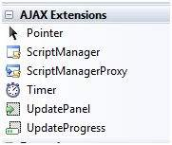
What Is AJAX in ASP.net
The usage of AJAX in ASP.net is fast growing these days as it helps you to create more dynamic, responsive, and better web applications. By using AJAX in ASP.net, the performance of an application is highly increased as the response time is reduced and the traffic between the server and the client is reduced as well.
AJAX stands for Asynchronous JavaScript and XML. This is a cross platform technology which speeds up response time. The AJAX server controls add script to the page which is executed and processed by the browser.
However like other ASP.NET server controls, these AJAX server controls also can have methods and event handlers associated with them, which are processed on the server side.
The control toolbox in the Visual Studio IDE contains a group of controls called the 'AJAX Extensions'

Slide 34
The ScriptManager Control
The ScriptManager control is the most important control and must be present on the page for other controls to work.
It has the basic syntax:
<asp:ScriptManager ID="ScriptManager1" runat="server">
</asp:ScriptManager>
If you create an 'Ajax Enabled site' or add an 'AJAX Web Form' from the 'Add Item' dialog box, the web form automatically contains the script manager control. The ScriptManager control takes care of the client-side script for all the server side controls.

Slide 35
The UpdatePanel Control
The UpdatePanel control is a container control and derives from the Control class. It acts as a container for the child controls within it and does not have its own interface. When a control inside it triggers a post back, the UpdatePanel intervenes to initiate the post asynchronously and update just that portion of the page.
For example, if a button control is inside the update panel and it is clicked, only the controls within the update panel will be affected, the controls on the other parts of the page will not be affected. This is called the partial post back or the asynchronous post back.
Note:synchronous postback renders the entire page for any postback
Asynchronous postback executes only one postback at a time, that is, if you have two buttons doing asynchronous postback, the actions will be performed one by one.

Slide 36
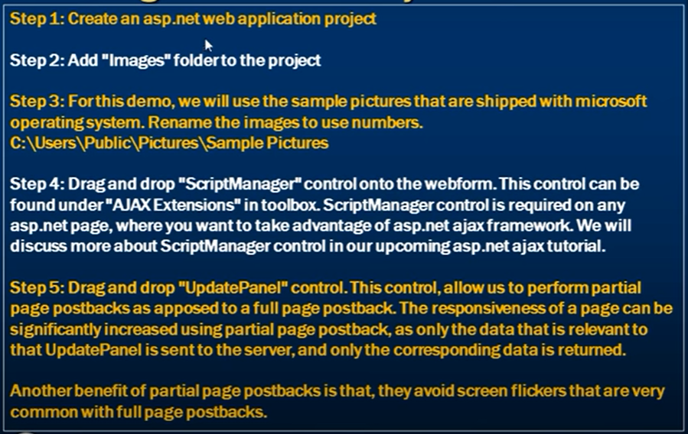
Web application to create an image slider using ajax

Slide 37
The Timer Control
The timer control is used to initiate the post back automatically. This could be done in two ways:
(1) Setting the Triggers property of the UpdatePanel control:
<Triggers>
<asp:AsyncPostBackTrigger ControlID="btnpanel2" EventName="Click" />
</Triggers>

Slide 38
(2) Placing a timer control directly inside the UpdatePanel to act as a child control trigger. A single timer can be the trigger for multiple UpdatePanels.
<asp:UpdatePanel ID="UpdatePanel1" runat="server" UpdateMode="Always">
<ContentTemplate>
<asp:Timer ID="Timer1" runat="server" Interval="1000">
</asp:Timer>
<asp:Label ID="Label1" runat="server" Height="101px" style="width:304px" >
</asp:Label>
</ContentTemplate>
</asp:UpdatePanel>

Slide 39
Web services
A web service is a web-based functionality accessed using the protocols of the web to be used by the web applications. There are three aspects of web service development:
Creating the web service
Creating a proxy
Consuming the web service

Slide 40
Creating a Web Service
A web service is a web application which is basically a class consisting of methods that could be used by other applications. It also follows a code-behind architecture such as the ASP.NET web pages, although it does not have a user interface.
To understand the concept let us create a web service to provide stock price information. The clients can query about the name and price of a stock based on the stock symbol. To keep this example simple, the values are hardcoded in a two-dimensional array. This web service has three methods:
A default HelloWorld method
A GetName Method
A GetPrice Method

Slide 41
Take the following steps to create the web service:
Step (1) : Select File -> New -> Web Site in Visual Studio, and then select ASP.NET Web Service.
Step (2) : A web service file called Service.asmx and its code behind file, Service.cs is created in the App_Code directory of the project.
Step (3) : Change the names of the files to StockService.asmx and StockService.cs.
Step (4) : The .asmx file has simply a WebService directive on it:
<%@ WebService Language="C#" CodeBehind="~/App_Code/StockService.cs" Class="StockService" %>
Step (5) : Open the StockService.cs file, the code generated in it is the basic Hello World service. The default web service code behind file looks like the following:

Slide 42
Step (6) : Change the code behind file to add the two dimensional array of strings for stock symbol, name and price and two web methods for getting the stock information.
Step (7) : Running the web service application gives a web service test page, which allows testing the service methods.
Step (8) : Click on a method name, and check whether it runs properly.
Step (9) : For testing the GetName method, provide one of the stock symbols, which are hard coded, it returns the name of the stock

Slide 43
Consuming the Web Service
For using the web service, create a web site under the same solution. This could be done by right clicking on the Solution name in the Solution Explorer. T
he web page calling the web service should have a label control to display the returned results and two button controls one for post back and another for calling the service.

Slide 44
Creating the Proxy
A proxy is a stand-in for the web service codes. Before using the web service, a proxy must be created. The proxy is registered with the client application. Then the client application makes the calls to the web service as it were using a local method.
The proxy takes the calls, wraps it in proper format and sends it as a SOAP request to the server. SOAP stands for Simple Object Access Protocol. This protocol is used for exchanging web service data.
When the server returns the SOAP package to the client, the proxy decodes everything and presents it to the client application.
Before calling the web service using the btnservice_Click, a web reference should be added to the application. This creates a proxy class transparently, which is used by the btnservice_Click event.

Slide 45
Take the following steps for creating the proxy:
Step (1) : Right click on the web application entry in the Solution Explorer and click on 'Add Web Reference'.
Step (2) : Select 'Web Services in this solution'. It returns the StockService reference.
Step (3) : Clicking on the service opens the test web page. By default the proxy created is called 'localhost', you can rename it. Click on 'Add Reference' to add the proxy to the client application.
Include the proxy in the code behind file by adding:
using localhost;

